Slide 1

SMARTGUARD
An Intelligent Child Safety and Monitoring System
Mohamed Alaraibi 202101014
Reem Madan 201901611
Sayed Qasim 202101072
Rahim Alrahim 202101849
Polytechnic Supervisor: Dr. Zakareya Hasan

Slide 2









CHILDREN MAY BE LEFT UNATTENDED INSIDE BUSES, CREATING SERIOUS SAFETY RISKS DUE TO THE LACK OF IMMEDIATE DETECTION AND AUTOMATED ALERTS.

Slide 3
Problem statement
Manual attendance and inspection are not failed safe.
No real-time verification after bus routes end.
Delayed response can lead to severe injury or fatality.
Existing systems lack automation and redundancy.

Slide 4
Driven to serve
1
2
Design an automated child presence detection system for school buses
Integrate multiple sensors to reduce false negatives
3
4
Implement multi-stage alert escalation.
Develop a reliable, scalable, and low-cost solution suitable for real deployment

Slide 5
Project Initiation phase
Stop 2
Project Objectives Definition:
Clear, measurable objectives guided the design of an intelligent child safety system with continuous monitoring and automated alerts.
Initial Resource Planning:
Determining required hardware and software
Stop 4
Problem Identification:
Safety incidents highlighted the need for an automated child safety system, and the project scope was supervisor-approved.
Stop 1
Stop 3
Initial Design:
Developed initial design sketches to outline the system structure and component placement.

Slide 6

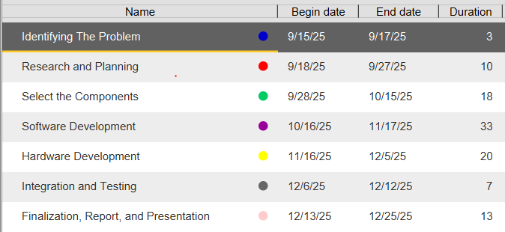
Work Plan and Timeline
A structured work plan and timeline were established to define key tasks, milestones, and deadlines. Team responsibilities were assigned, and progress was continuously monitored using a Gantt chart.

Slide 7
Execution Phase
System Development
& Hardware
Integration
& Testing
Improvements & Progress Tracking
Hardware and software components were developed in line with the system architecture, including sensors, controllers, and a monitoring dashboard.
System components were integrated and tested to verify detection accuracy, real-time alerts, and emergency response behavior.
Issues were resolved through iterative improvements and regular progress reviews to maintain alignment with project objectives and timeline.

Slide 8
Testing & Validation Phase
1
2
3
Validation Process
System performance was validated against project objectives to ensure reliable detection, timely alerts, and safe operation.
Testing Approach
System testing used functional and scenario-based cases to verify sensor accuracy, detection logic, and alert escalation under varied operating conditions.
Outcome
All critical system functions operated as intended, meeting safety and reliability requirements.

Slide 9
Final Deployment Phase
System Assembly
System Readiness
Demonstration
The final prototype integrated all hardware into a compact enclosure, ensuring secure and reliable operation.
Final checks confirmed system stability, communication functionality, and deployment readiness.
The completed system was demonstrated to verify overall functionality and practical applicability in a school transportation environment.

Slide 10
CHALLENGES
During the development of the system, several technical and logistical challenges were encountered:
C1001 Sensor Calibration Issues
Digital Pins Limitation
C1001 and GPS Pin Conflict
Component Delivery Delays and Damages
Camera Limitations
Integration Complexity

Slide 11
Since we faced several issues at the start of the execution phase, we implemented some modifications, the most important of which were:
Oxygen Sensor:
Limited options are available in the market, and high-quality sensors are expensive.
IR Sensor:
Upgraded to a higher-range infrared sensor for improved detection accuracy.
Thermal Sensor:
Added to enhance child detection based on body temperature.
Camera:
Upgraded for better face detection and live monitoring.
Digital Pin Extension:
The available digital pins were insufficient for the project requirements. therefore, a digital pins extension was implemented as the selected solution.

Slide 12
Context Overview
Legal | Economic | Commercial
The system complies with national and international child safety regulations and transportation laws to ensure full legal adherence.
The project has potential for adoption in school buses, public transport, and private fleets, offering a marketable safety solution.
Designed to be cost-effective, using affordable components, low maintenance, and minimizing operational costs.
Safety | Environmental | Societal
The system enhances child safety by providing continuous monitoring, automated alerts, and timely emergency responses.
Low-power electronic components were selected to minimize energy consumption and environmental impact.
The project contributes positively to society by protecting children, increasing parental trust, and improving overall school transportation safety.

Slide 13
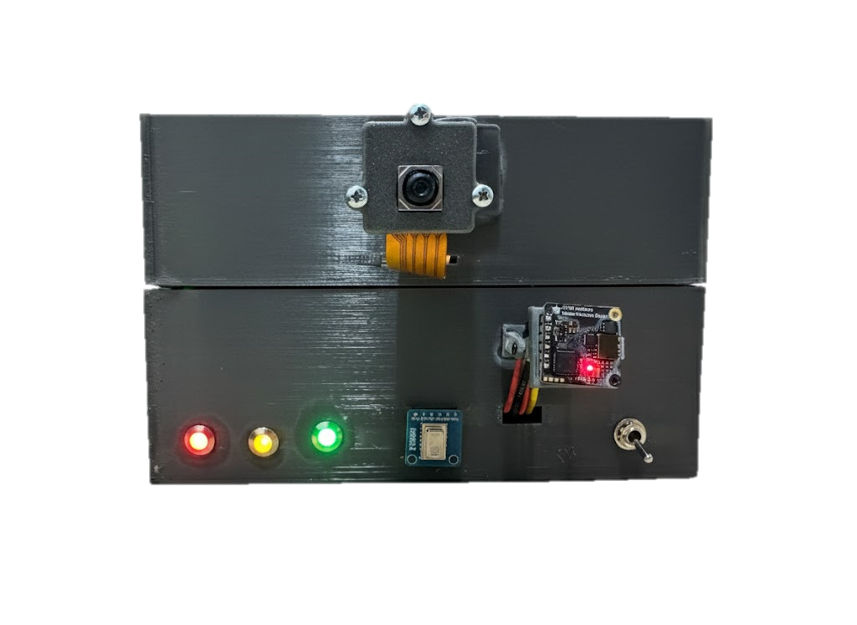
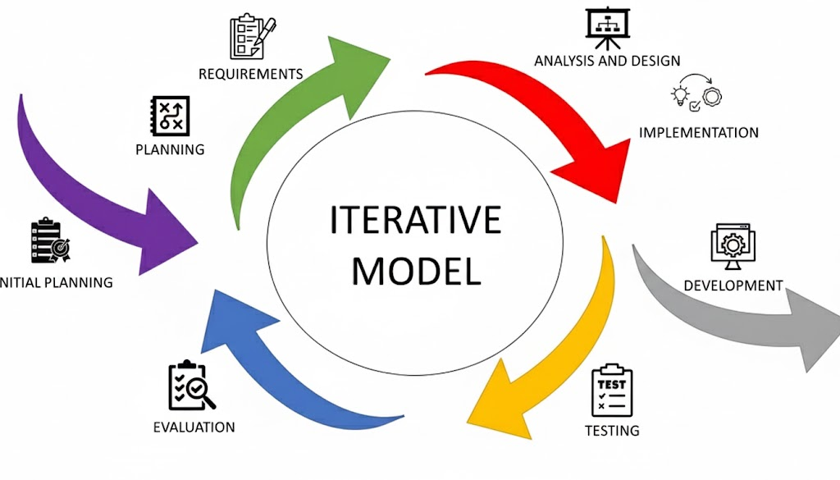
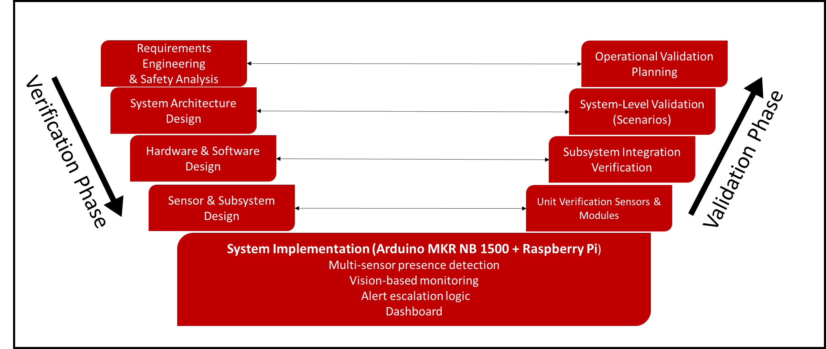
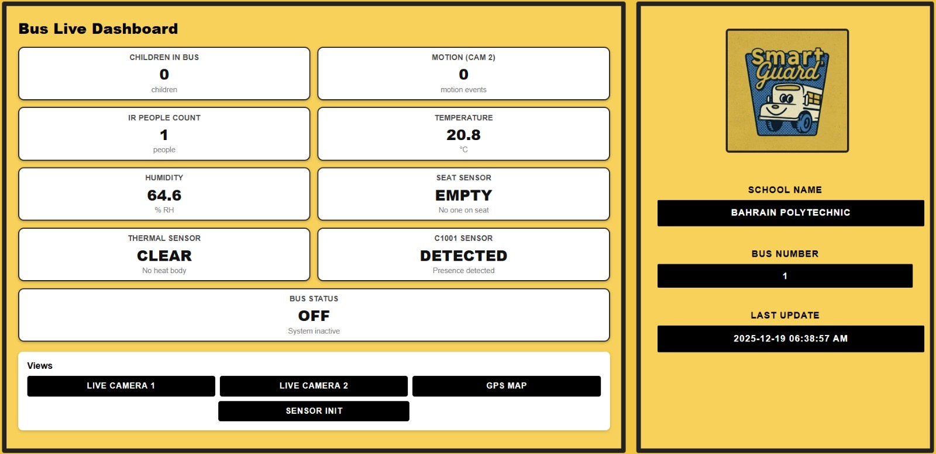
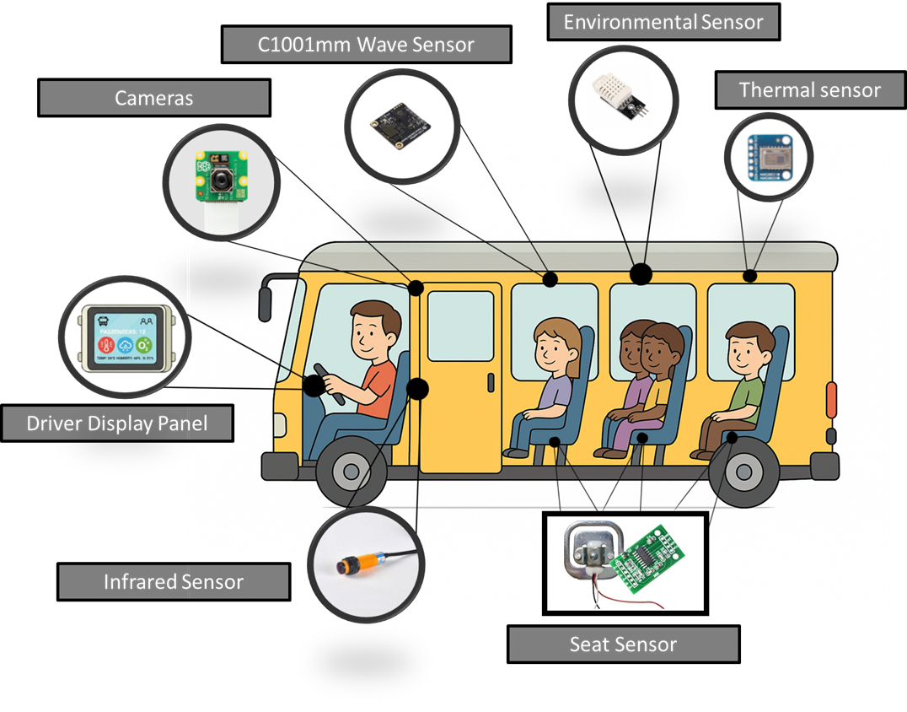
G
PLANNING
TESTING
F
Existing solutions were compared to identify key shortcomings. Based on this analysis, an automated multi-sensor system was selected to address the problem, enabling independent decision-making and action without reliance on human intervention.
E
IDENTIFICAION
Multiple simulated scenarios were designed, and comprehensive sequential tests were conducted to cover potential situations inside the bus. This verified the correctness of the action sequence and confirmed that the system responds as intended and delivers reliable results.
SYSTEM DESIGN
INTEGRATION AND DASHBOARD
FINAL ASSEMBLY
Implementation
Procedure
And
Processes
Procedure and process
Sensors and system components were selected based on their suitability to meet the project objectives and ensure effective operation. An initial conceptual system design was developed to guide implementation and integration.
Past school bus safety incidents were analyzed to identify the root causes of children being left unattended. Existing solutions and technologies were then evaluated to highlight their limitations and identify areas requiring improvement.
D
All system components were integrated into a unified platform, and a centralized dashboard was developed to collect, visualize, and manage data from all modules for efficient monitoring and control.
The PCB was designed and assembled, and all components were integrated onto it. The complete setup was then installed into the final prototype, creating a fully functional version of the system.
The system was divided into two main subsystems: sensor-based detection and camera-based monitoring. Each component was developed and tested independently to ensure reliable functionality before integration.
C
B
A

Slide 14
Tests and Designs!
To achieve a reliable final system, multiple design and testing stages were conducted. Each component was designed, programmed, and tested to ensure accuracy, reliability, and proper integration within the school bus environment.

Slide 15




Multi-layer system architecture.
Reliable detection and response.
Minimize false detection.
System Diagram

Slide 16



Decision logic to prevent false alarms during operation.
A staged response strategy.
Automated safety system.
Preventing human error.
FLOWCHART

Slide 17
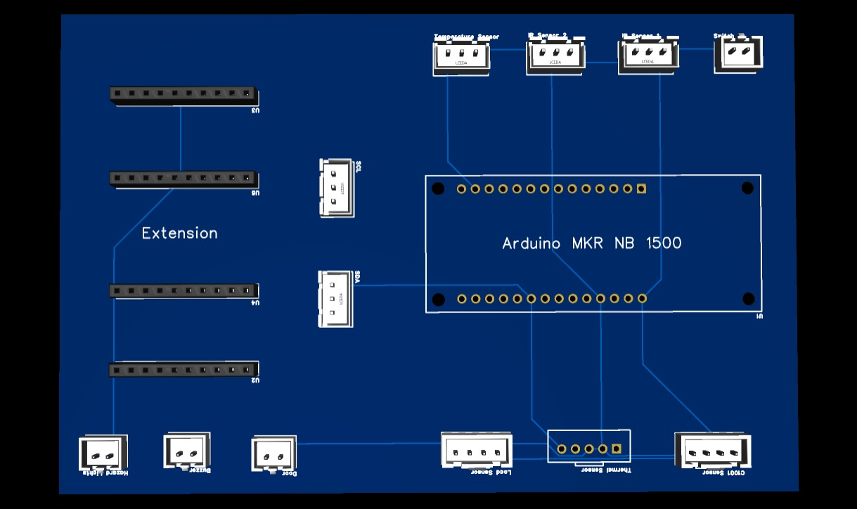
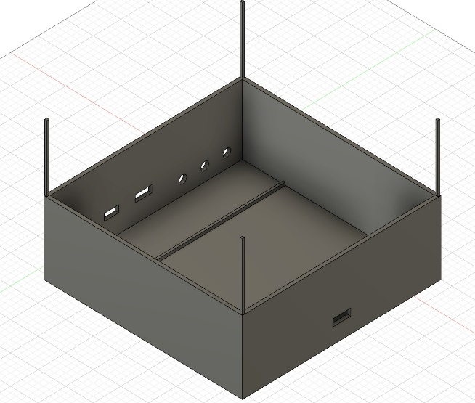
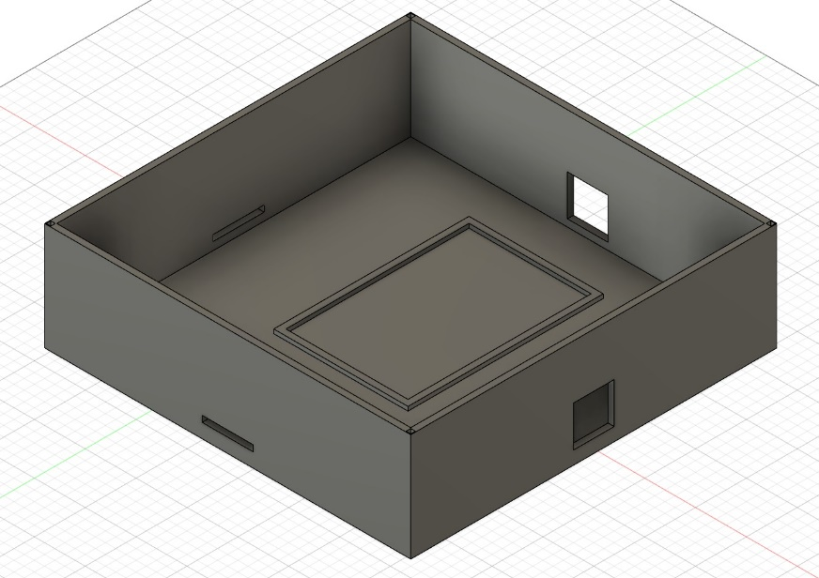
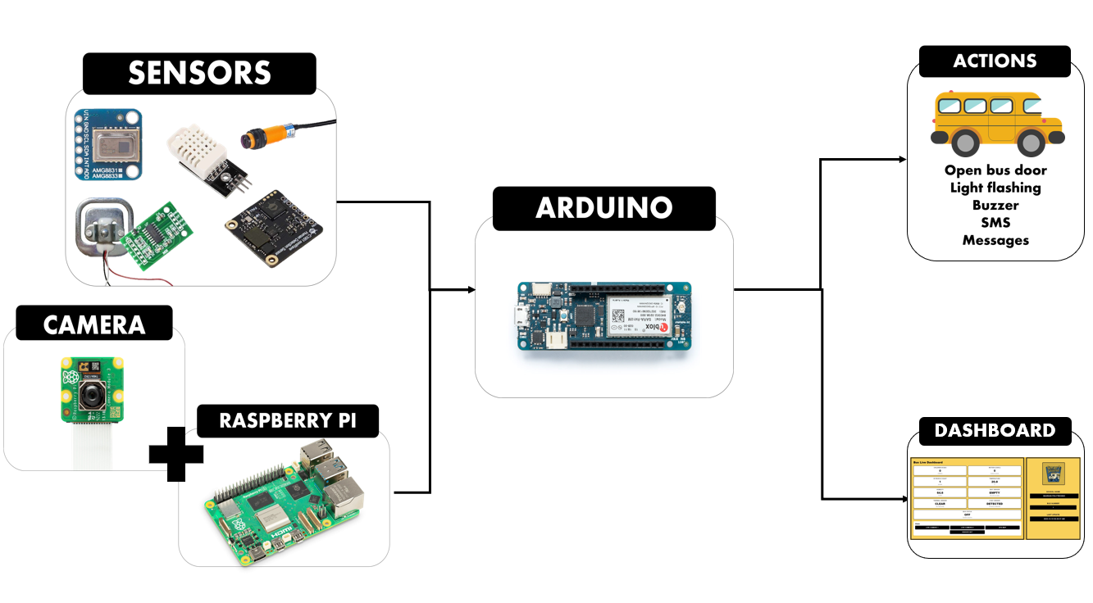

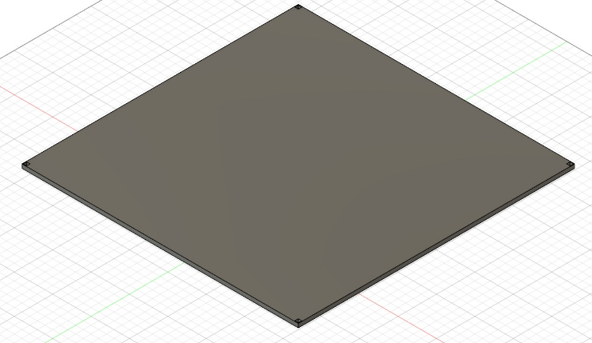
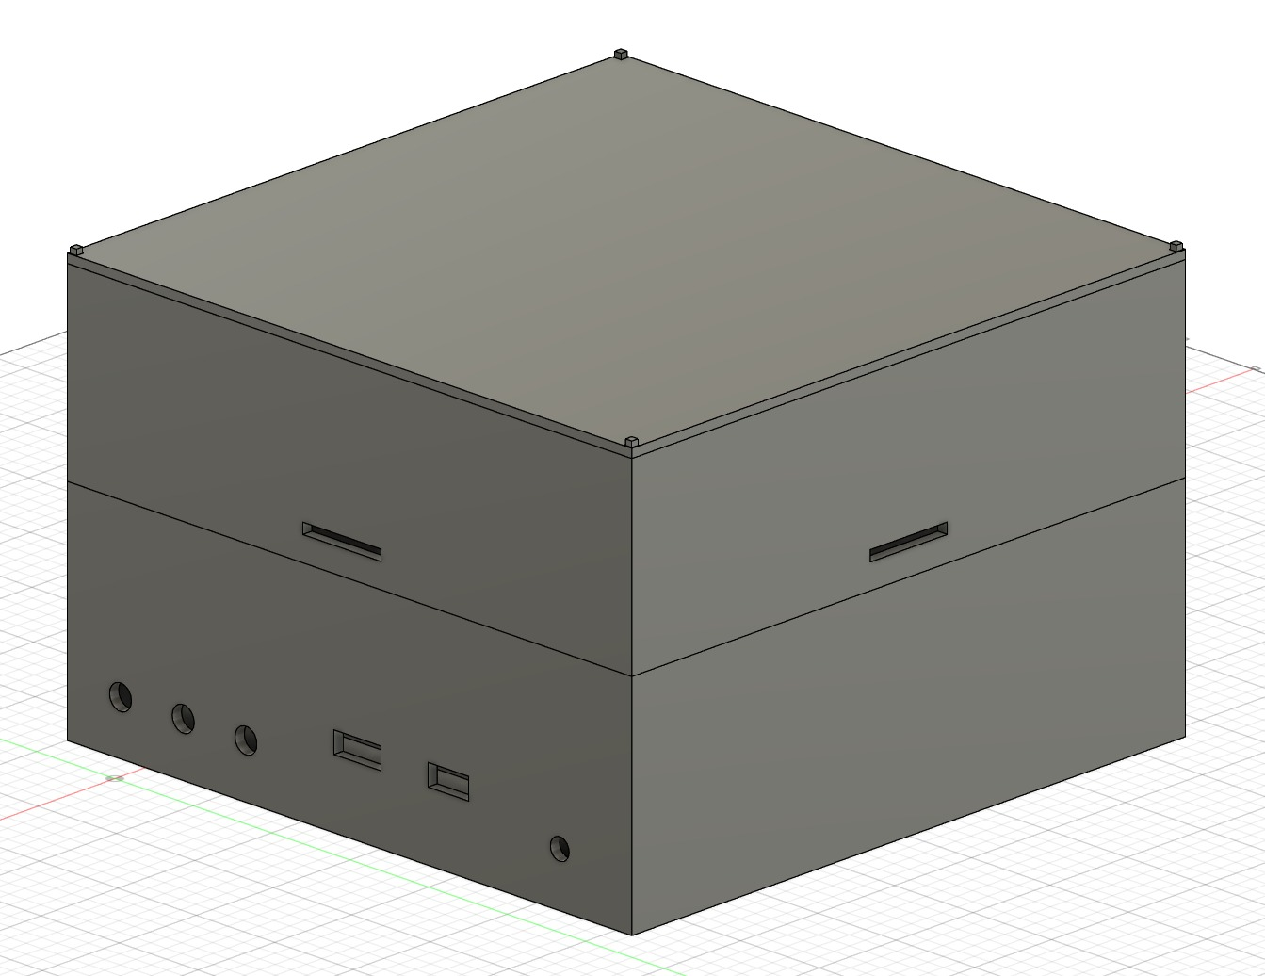

Multi-layer design detects both motion and stationary occupants.
Support real-time decision-making.
A custom enclosure and PCB layout were designed to improve stability, safety, and maintainability.
System Architecture

Slide 18

A real-time dashboard displays sensor status, alerts, camera feed, and bus location.
Supports transparent system verification and fast intervention when needed.
Actions levels
DASHBOARD
Actions

Slide 19
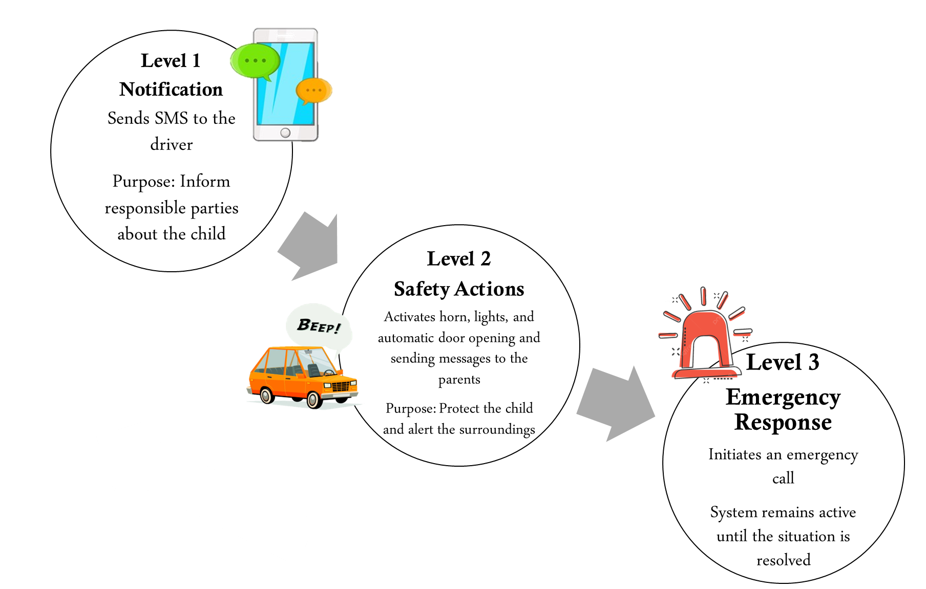
Actions levels
Actions

Slide 20
Planned testing using functional, integration, and real scenario-based test cases.
Test scenarios were designed to cover normal operation, emergency cases, and failure conditions.
Scenario ID | Description | Purpose
T1 | Single child seated with minimal movement | Validate motionless human detection using mm Wave, thermal, and load sensors
T2 | Child sleeping on seat | Verify detection of low-activity occupants and confirm mm Wave, thermal, and load sensor reliability
T3 | Multiple passengers entering and exiting | Evaluate passenger counting accuracy using IR sensors and camera-based counting
T4 | Single sensor false trigger (noise or transient detection) | Test false alarm prevention and multi-sensor validation logic
T5 | Multi-sensor human detection after engine OFF | Validate correct emergency trigger conditions and decision logic
T6 | Prolonged unattended presence after engine OFF | Assess time-based alert escalation behavior
T7 | Engine ON with multi-sensor human detection | Confirm that no emergency actions are triggered when ignition is ON
T8 | Camera-only detection scenarios (Cam1 and Cam2) | Evaluate camera authority levels and interaction with sensor confirmation logic
T9 | Child lying on the bus floor | Verify detection capability for non-seated, low-profile human presence

Slide 21
Test ID | Description | Result
T1 | Single child seated with minimal movement | Detected by: C1001 sensor, Load sensor, Thermal sensor, IR sensors, and cameras.
T2 | Child sleeping on seat | Detected by: C1001 sensor, Load sensor, and Thermal sensor. IR sensors and camera-1 (counter).
T3 | Any sensor failure | The failure appears in the dashboard. SMS to the driver
T4 | Multi-sensor human detection after engine OFF | The action sequence is activated
T5 | Engine ON with multi-sensor human detection | No emergency actions are triggered when ignition is ON. Monitoring mode (Dashboard)
T6 | Child lying on the bus floor | Detected by: C1001 sensor, Load sensor, Thermal sensor, IR sensors, and cameras.
Test ID | Description | Result
T1 | Single child seated with minimal movement | Detected by: C1001 sensor, Load sensor, Thermal sensor, IR sensors, and cameras.
T2 | Child sleeping on seat | Detected by: C1001 sensor, Load sensor, and Thermal sensor. IR sensors and camera-1 (counter).
T3 | Any sensor failure | The failure appears in the dashboard. SMS to the driver
T4 | Multi-sensor human detection after engine OFF | The action sequence is activated
T5 | Engine ON with multi-sensor human detection | No emergency actions are triggered when ignition is ON. Monitoring mode (Dashboard)
T6 | Child lying on the bus floor | Detected by: C1001 sensor, Load sensor, Thermal sensor, IR sensors, and cameras.
Condition ID | Ignition State | Active Detection Sources | Emergency Action
C1 | ON | Any single or multiple sensors | No action
C2 | ON | Any camera | No action
C3 | OFF | Single sensor only | No action
C4 | OFF | Camera 2 only | No action
C5 | OFF | Any 2 or more sensors | Actions activated
C6 | OFF | Sensor + Camera 2 | Actions activated
C7 | OFF | IR passenger count > 0 + Sensor or Camera 2 | Actions activated
C8 | OFF | Camera 1 detects face | Actions activated
C9 | OFF | Camera 1 count > 0 | Actions activated

Slide 22
Component | Detection / Function Method | Performance Outcome | Key Observations
C1001 mmWave Sensor | Presence and micro-movement detection | High accuracy after calibration | Effective for detecting motionless occupants
AMG8833 Thermal Sensor | Body heat detection (thermal array) | Very high reliability | Independent of lighting conditions
HX711 Load Cell | Seat pressure sensing | Stable and consistent readings | Requires correct calibration and seat placement
IR Motion Sensors | Infrared motion detection | Fast response | Limited effectiveness for stationary occupants
DHT Sensor | Temperature and humidity monitoring | Accurate environmental readings | Supports heat-risk assessment, not presence detection
Camera 1 (Face Recognition) | Visual identification of faces | High confidence detection | Allows direct alert triggering due to high reliability
Camera 2 (Motion Detection) | Visual motion tracking | Reliable for movement detection | Requires confirmation from other sensors
GPS Module | Real-time location tracking | Accurate positioning | Enables location reporting during emergencies
Ignition Status Input | Engine ON/OFF state detection | Highly reliable | Prevents false alarms during bus operation
Multi-sensor fusion improved reliability and reduced false alarms.
Sensors-based, and vision-based detection achieved high accuracy.
GPS and ignition-state logic ensured safe and context-aware system operation.

Slide 23
Test ID | Description | Result
T1 | Single child seated with minimal movement | Detected by: C1001 sensor, Load sensor, Thermal sensor, IR sensors, and cameras.
T2 | Child sleeping on seat | Detected by: C1001 sensor, Load sensor, and Thermal sensor. IR sensors and camera-1 (counter).
T3 | Any sensor failure | The failure appears in the dashboard. SMS to the driver
T4 | Multi-sensor human detection after engine OFF | The action sequence is activated
T5 | Engine ON with multi-sensor human detection | No emergency actions are triggered when ignition is ON. Monitoring mode (Dashboard)
T6 | Child lying on the bus floor | Detected by: C1001 sensor, Load sensor, Thermal sensor, IR sensors, and cameras.

Slide 24



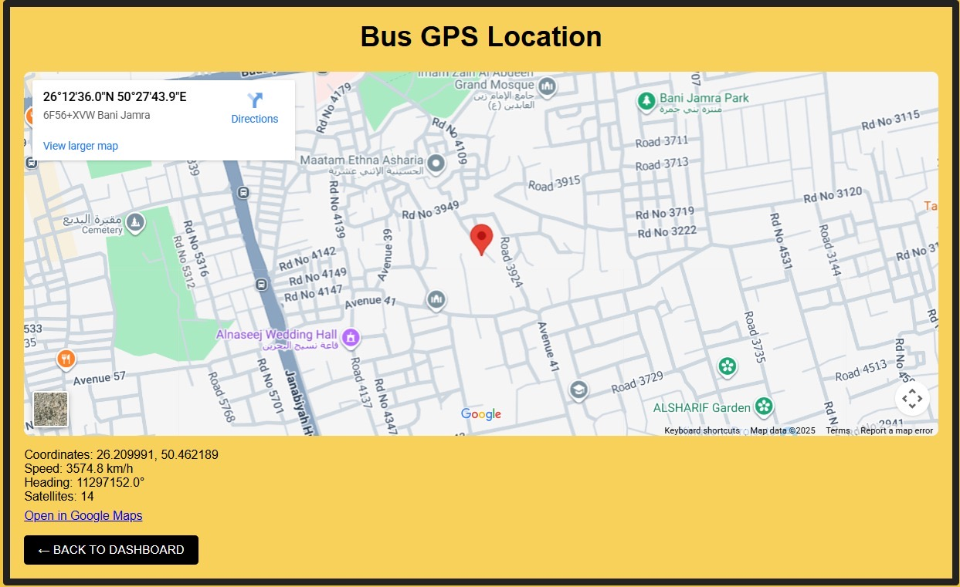
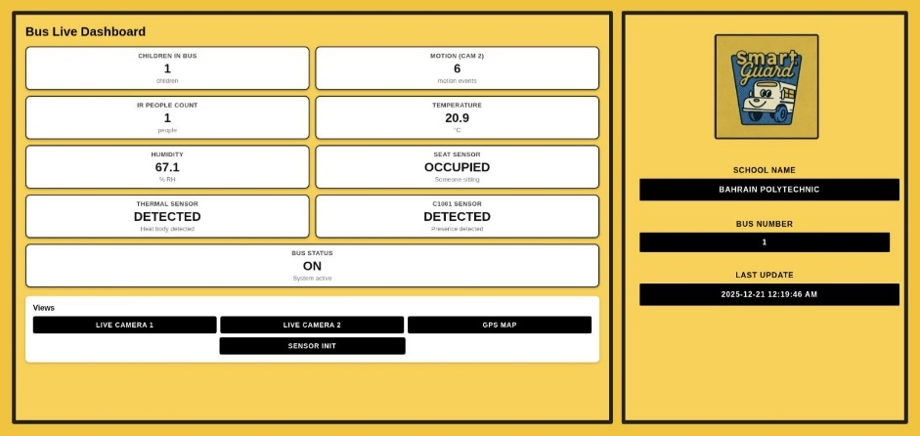
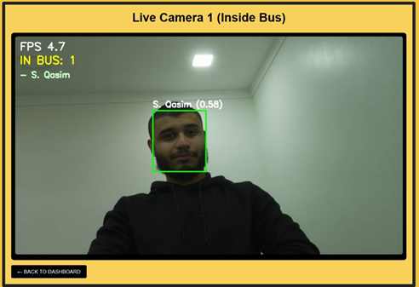
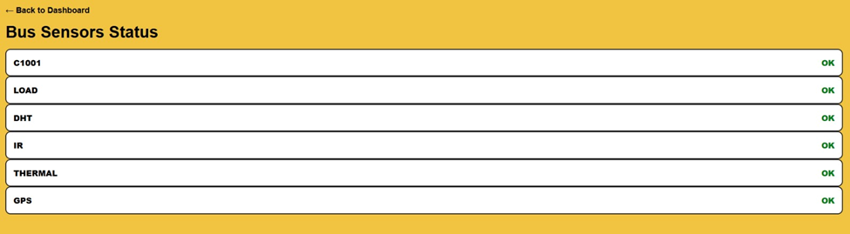
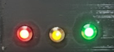
Accurate child presence detection across all scenarios.
Correct alert escalation without false triggering.
Stable system performance after integration.
Readiness for final deployment.

Slide 25


Evaluated against defined project objectives
Correct detection and alert escalation achieved
False alarms reduced through multi-sensor validation
Evaluation and Quality of Results
Consistent and repeatable system behavior
Reliable and safe performance for a safety-critical application

Slide 26
CONCLUSION
SmartGuard successfully delivers a reliable, automated child safety system for post-trip school bus monitoring.
The multi-sensor and vision-based approach enhances detection accuracy and significantly reduces reliance on human supervision.
The system demonstrated robust performance under tested scenarios, with effective alert escalation and emergency response.
SmartGuard is well-suited to Bahrain’s school transportation context and provides a strong foundation for real-world deployment and future enhancement.

Slide 27
Thank you
We welcome any questions

